Slide 1
Monitoring of Key Practices to Impact English Learner Reclassification
March 2017
Notes:
1 minute
Introduce yourself
Explain that there is a parking lot. If there are any questions, they are more than welcome to write it on a post it and place it on the parking lot.

Slide 2
Engaged Participant Outcomes
Review the updated monthly Reclassification Rate Monitoring Report
Discuss the LAUSD CELDT opportunity and next steps for support
Delve into Start Smart 2.0 resources to review the skills students will build and the practices teachers will use during Designated ELD instruction
Notes:
13 minutes for Introduction (Slides 1 – 9)
1 minute
These are our learning outcomes for today.
Click on animation:
Have volunteer participants read each outcome.

Slide 3
System Support
As we lead reclassification efforts, what systems, structures and evidence will result in improved student learning and teacher effectiveness for English Learners?
Notes:
30 seconds
Note to presenter: This slide is shown at every Principals’ meeting.
Say: As we enter the final months of instruction for this year, we have to remember that our essential question continues to guide our work in schools and in providing leadership to teachers on reclassification efforts.

Slide 4
Elementary Roadmap to Reclassification
Notes:
1 minute
Click animation
Say: This past Monday, the window for LAUSD’s CELDT 2nd administration opened. We know that targeted instruction has been and continues to be given to students to help to them capitalize on this opportunity. This assessment opportunity will be discussed in further detail in the next couple of slides.
Click animation
Say: During the past couple of months, principals and teachers have been and will continue to review the results of DIBELS MOY to plan and implement appropriate differentiation and interventions. In grade level meetings teachers, coaches and school leaders should identify successful practices and begin to look for patterns and trends for SSPT.

Slide 5
Next Opportunity to Reclassify
Planning for upcoming reclassification opportunity:
Elementary | Secondary
LAUSD-CELDT March 13-March 24, 2017 Single Track schools | LAUSD-CELDT March 13-March 24, 2017 Single Track schools
Reporting Period 2 Marks: Submit: February 9-March 3, 2017 Used as criteria until June. 2017 | Reading Inventory: April 24th – May 26th, 2017 Used as criteria until June 2017
Notes:
1 minute
click animation
Say: Elementary Report cards were finalized on March 3, 2017- This is the time to start reviewing data and having conversations with teachers about how to support EL students who are not receiving passing marks.
Click animation
Say: As stated in the last slide, the window for LAUSD’s CELDT opened on Monday, and will close next Friday, March 24th.

Slide 6
LAUSD-CELDT Criteria
EL Profile | Grades | Students Eligible | 2016-17 Annual CELDT | 2016-17 Basic Skills Assessment | 2016-17 Report Card Marks/Grades
E | 2-12 | All English Learners | Not Meeting | Meeting | Meeting
F | 2-12 | All English Learners | Not Meeting | Meeting | Not Meeting
G | 4-12 | P-LTELs and LTELs only | Not Meeting | Not Meeting | Meeting
H | 4-12 |  | Not Meeting | Not Meeting | Not Meeting
Notes:
90 seconds
Say: This graph displays the criteria for the March LAUSD CELDT based on student profiles. Please note special education English Learners need to have their IEP reviewed to identify the language assessment identified.
Click on animation
Say: The students selected are specific students in Profile E-H who did not meet the CELDT criteria during the fall administration.
Click animation
Say: During this CELDT administration, please remember that your Profile E and F students who are being given the CELDT are students in grades 2-12 have who already met DIBELS or RI.
Click animation
Say: The students in Profile G and H are PLTELs and LTELs in grades 4-12 who did not meet DIBELS or RI. The goal is that these students can pass CELDT, and will have another opportunity with EOY, or for 6th graders, the second administration of RI. After the CELDT administration, we recommend that you meet with the EL Designee at your school site, and develop a game plan to provide differentiated support for these students.
Click animation
Say: And finally, we need to make sure that we continue to monitor student progress before the 3rd reporting period. A good indicator of current student progress is the 2nd reporting marks that just came out.
.

Slide 7

How are you using Student Support Progress Team to support and monitor English Learners?
SSPT
TURN & TALK
Reclassify ELs
Monitor and Intervene
P-LTELs, LTELs and
ELs not making adequate progress
SSPT Website:
http://achieve.lausd.net/SSPT
Notes:
4 minutes
Say: The SSPT can be used in many ways-here are two ways
Click animation
Say: One way is to bring Profile B student cases to review their grades which are the only missing criteria to reclassify. If there is enough evidence to support reclassification then the team can recommend and reclassify. Remember, after the SSPT has convened, and if reclassification is recommended, all the documents must be submitted to Rafael Escamilla for review. If the students are not recommended for reclassification, then the team should determine what supports should be put in place for the student to earn the grades during the last reporting period. Currently, there are 65 elementary students in Local District West who are in Profile B.
Click animation
Say: Another way to utilize SSPT to support student progess is to hold SSPT meetings for student cases that are not meeting 2 or more criteria to reclassify and prioritize by years as English Learner, starting with the students with the highest number of years as English learners. For example elementary should look at 5th graders with 5 or more years not meeting criteria and hold those meetings first. Then 4th graders with 5 or more years and so on…. This will help with prioritizing interventions.
Click Animation
Say: How are you using the SSPT to support and monitor English Learners? Please turn to an elbow partner to discuss how your SSPT helps to support and monitor English learners. (2 minutes)
Have 2 people share out after partner talk. (1 minute)

Slide 8
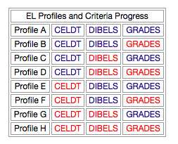
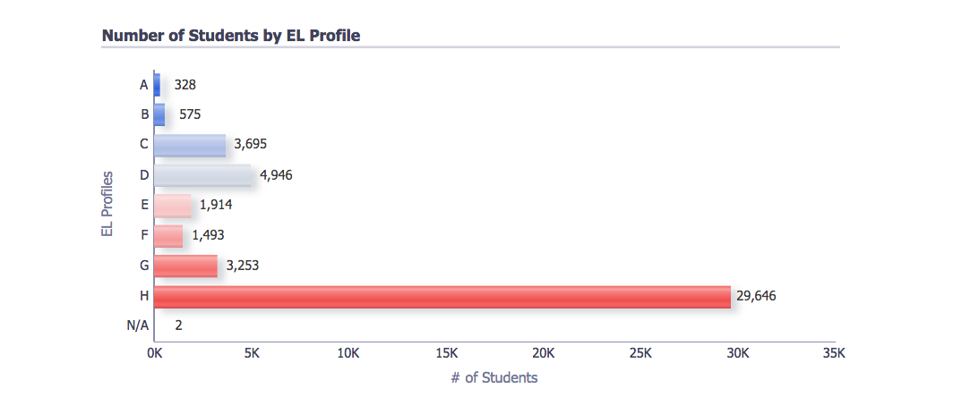
EL Profile B Student Actions
Hold SSPT meeting. Discuss grades and support with teachers.
EL Dashboard 2.28.17
Notes:
30 seconds
Click animation
Say: Principals please use the EL dashboard to identify profile B students and Hold SSPT meeting. Discuss grades and support with teachers.

Slide 9
EL Profiles: Targeted Instruction and Support
Monitor and Intervene
EL Dashboard 2.28.17
Notes:
30 seconds
Click animation
Say: Principals, for Profile C-H students, the SSPT can help to inform staff on how to provide targeted support.

Slide 10
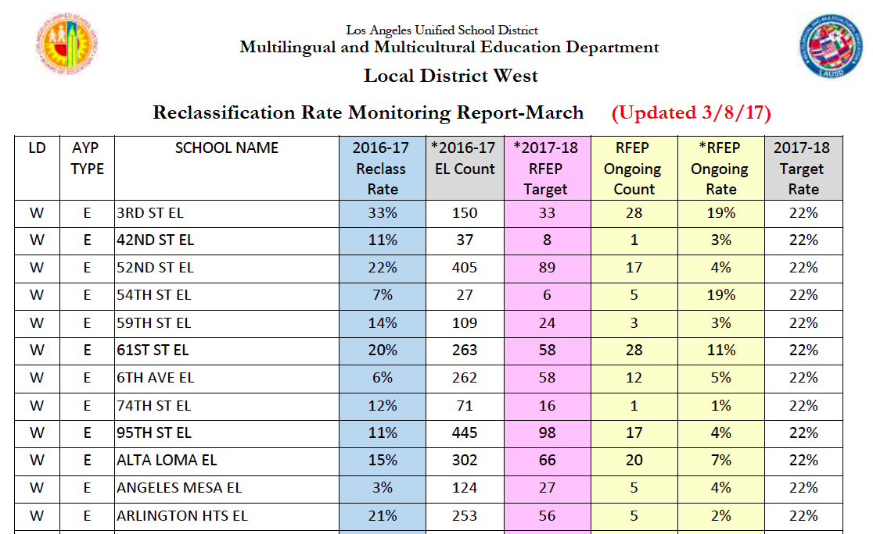
Objective #1
Use of Reclassification Data
Number has been adjusted to reflect official CALPADS #
(to include new TK/K ELs and newcomers)
For most schools, this means RFEP Target # has adjusted
For some schools, this means Ongoing Rate
has also adjusted
Notes:
2 minutes
Say: You have already received your monthly reclassification reports and have looked at your current progress towards the 22% goal. This reclassification report captures all the students reclassified with 2nd reporting period grades. We know there have been some adjustments to some of the numbers in the report which impacts the RFEP Target Number and therefore our Reclassification Ongoing Rates. To review:
Click animation and read the arrow
Click animation and read the arrow
Click animation and read the arrow

Slide 11
Our Moral Imperative
At the core of equity is understanding who your kids are and how to meet their needs. You are still focused on outcomes but the path to get there may not be the same for each one.
Pedro Noguera
Notes:
1 minute

Slide 12
Start Smart 2.0
Notes:
30 seconds
Knowing that we impact student achievement through quality first instruction, we have an opportunity today to delve into the practices we want to observe as teachers support language development with the use of the Start Smart 2.0 resources.

Slide 13
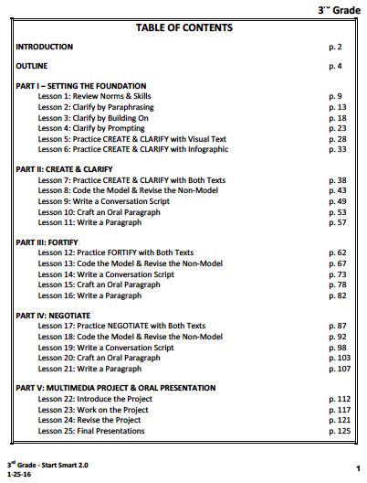
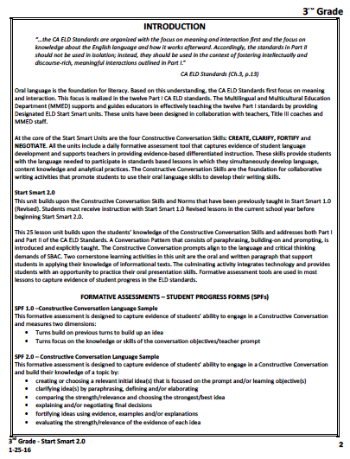
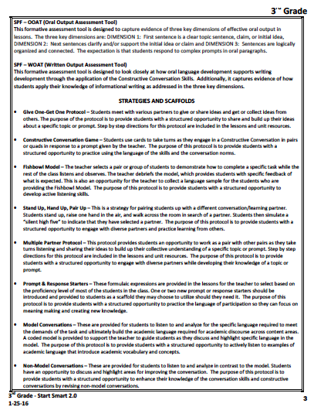
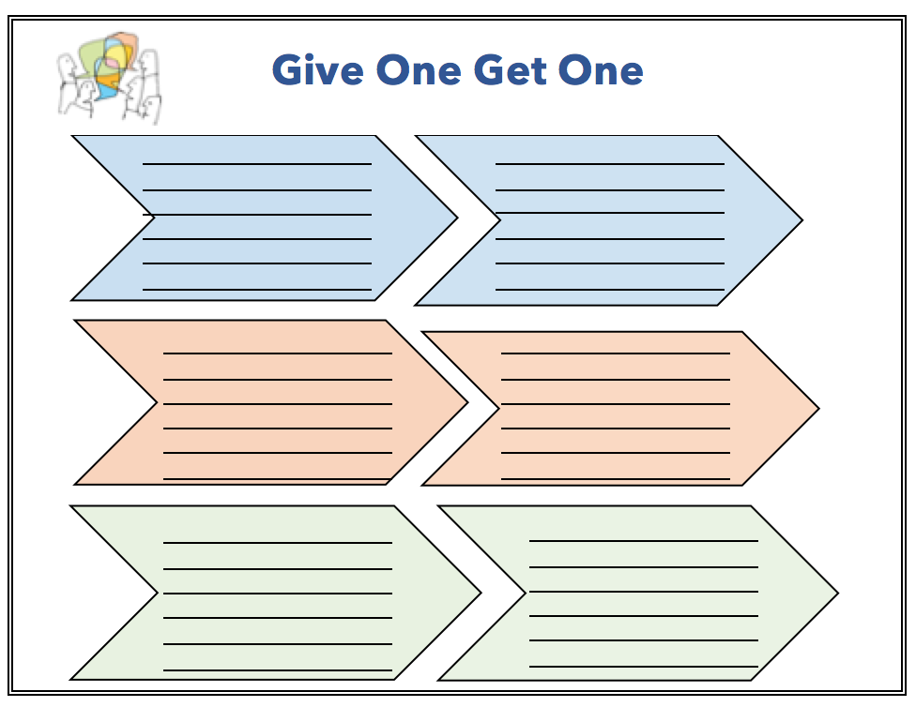
Start Smart 2.0
Scan the Table of Contents and Introduction, pages 1-3, including the Formative Assessment & Strategies and Scaffolds sections
  What skills will your students be developing during these lessons?
  What practices will your teachers be using during these lessons?
Notes:
3 minutes
Give participants around 2 minutes to scan the tables of contents and introduction with key questions in mind. After you have given them this time, click the animation for the Give One, Get One icon and tell them that we will use this protocol to capture some of the skills and practices we noticed and to share them with others.

Slide 14
Give One, Get One
Notes:
7 minutes
Ask the principals to write down three ideas about skills students will develop and practices that teachers will use in the section in the first column “My 3 Ideas”
Explain the protocol.
They will get up and find a partner from a different table.
They will each share their first idea and then after sharing and listening attentively, they will write down their partner’s idea.
You will bring everyone together with the hand signal to prepare for finding the second partner to exchange idea number two and again for the third exchange.
When you are finished have three people share out about something principals should observe during instruction using Start Smart 2.0.

Slide 15
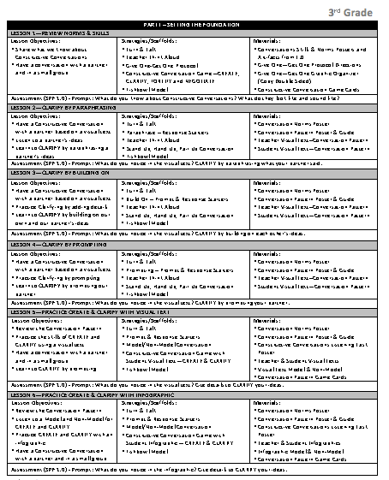
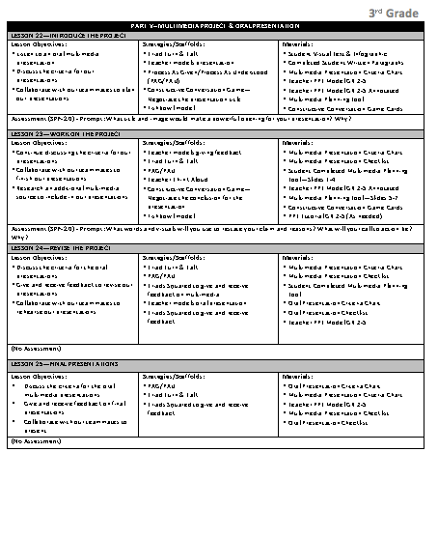
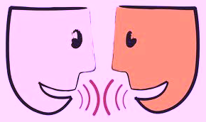
Start Smart 2.0
Outline, Grade 3
Pull pages apart
Scan Part I and Part V
  What do you notice?
  What do you wonder?
Turn & Talk
Notes:
4 minutes
Give your participants 2 minutes to look over the outline, 1 minute to discuss with their partner their noticings and wonderings and 1 minute for a share out.

Slide 16
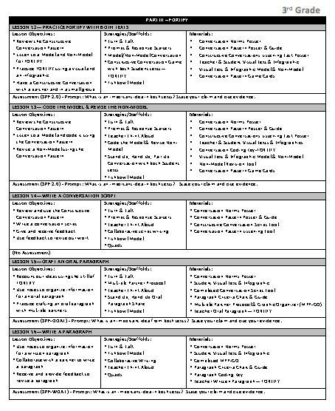
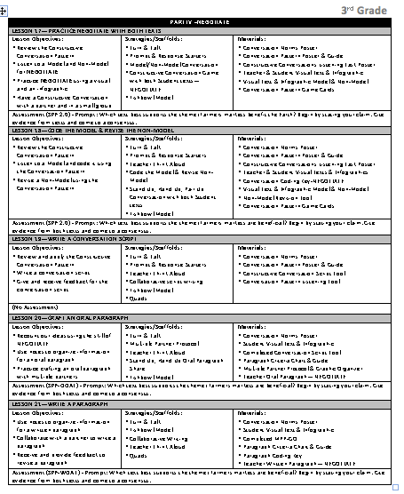
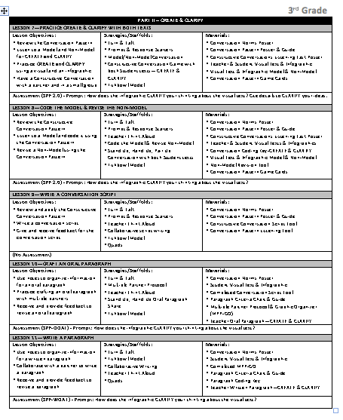
Start Smart 2.0
Outline, Grade 3
Now scan Parts II, III, and IV
  What do you notice?
  What do you wonder?
Turn & Talk
Reminder:
Start Smart 2.0 is a 25 lesson series, not a 25 day series. We anticipate it will take more than 25 days considering many of the practices are new to both students and teachers.
It is obviously all about the language learning of the students. In addition, we want to see many of these teaching practices used both Designated ELD and Integrated ELD after the completion of Start Smart 2.0.
Notes:
5 minutes
Give your participants 2 minutes to look over the outline, 1 minute to discuss with their partner their noticings and wonderings and 1 minute for a share out.
Pages 2, 3 and 4 have the same layout. Participants should identify there is a pattern within the unit the only thing that changes on pages 2,3, and 4 are the skill taught. Surface this pattern if it is not noticed.
1 minute to share “reminder”

Slide 17
Formative assessment
Notes:
30 seconds
We are now going to spend sometime looking at the formative assessment opportunities built into the Start Smart 2.0 lessons.

Slide 18
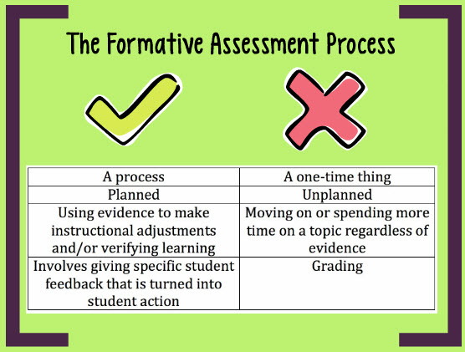
Notes:
1 minute
Read what formative assessment is and what it is not.

Slide 19
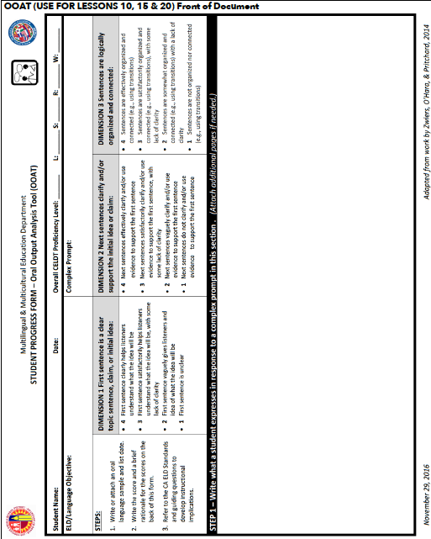
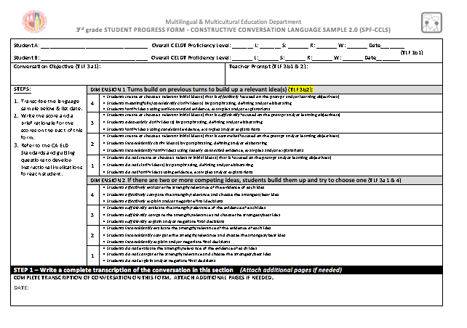
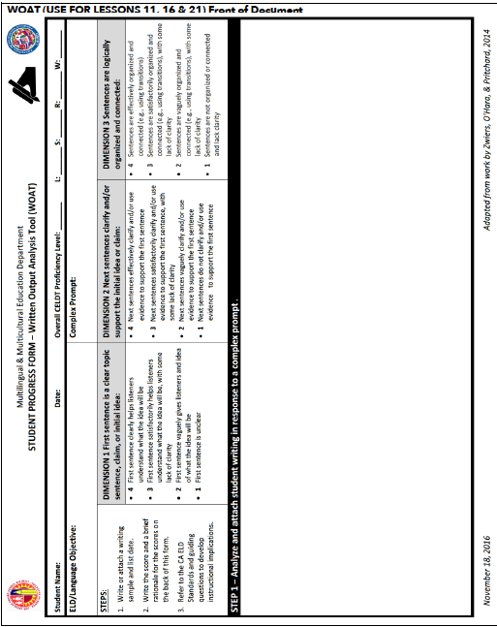
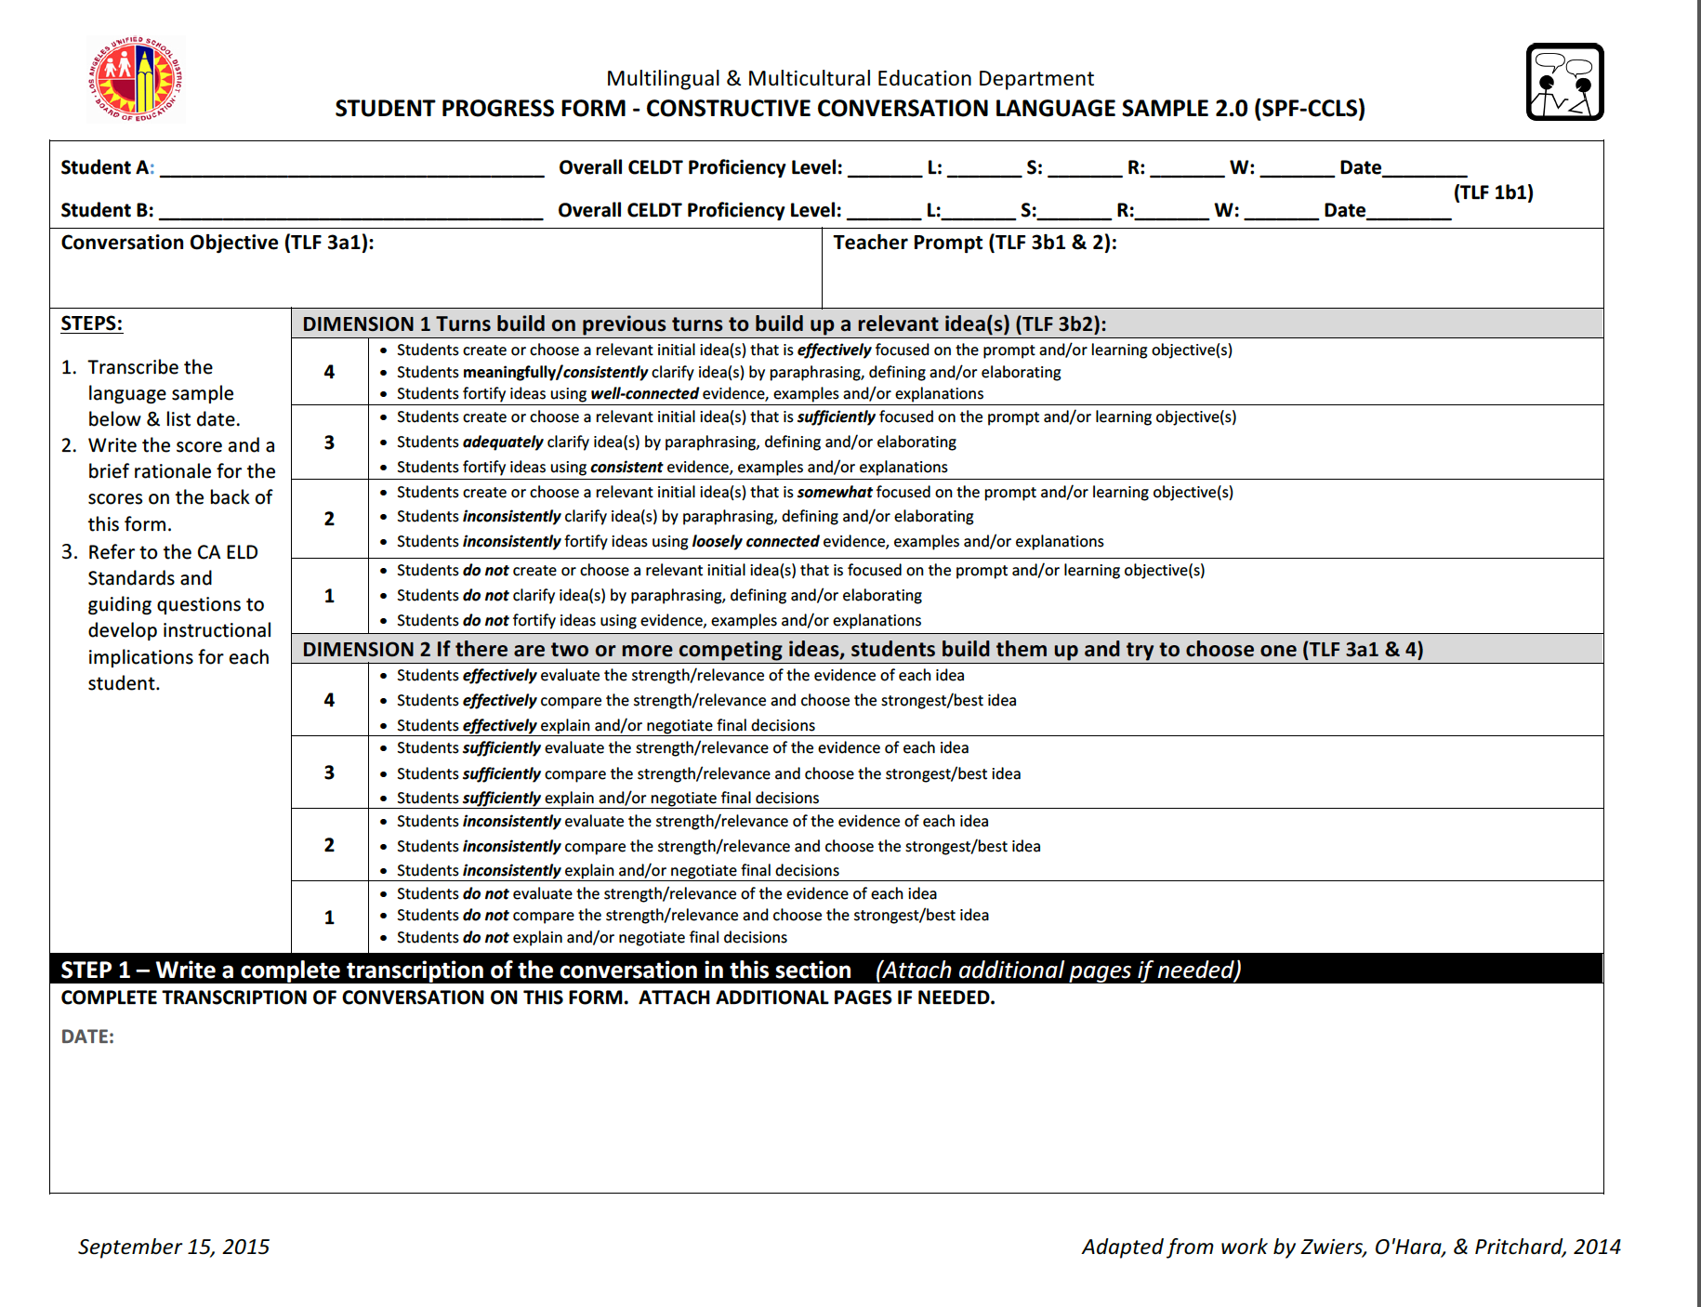
Formative Assessment Overview
SPF 1.0 Student Progress Form 1.0 (introduced last year) Measures building up an idea in a conversation and answering the prompt | OOAT Oral Output Analysis Tool (new) Measures students speaking in connected sentences (main idea, details, and transitions)
SPF 2.0 Student Progress Form 2.0 (new) Measures building up one or more ideas in a conversation and then evaluating the evidence supporting each idea to negotiate in selecting in the best idea | WOAT Written Output Analysis Tool (new) Measures students writing in connected sentences (main idea, details, and transitions)
Notes:
2 minutes
Explain that there are 4 formative assessment tools used during Start Smart 2.0 to gather data regarding students and to guide instructional decisions.
Read the slide to give a very brief overview of the 4 assessments.
Although not on the slide, please talk about the fact that the SPF 1.0 and 2.0 gather information about a conversation between two students while the OOAT and WOAT are individual formative assessments.

Slide 20
Formative Assessment Quad Dig In
Form a quad.
Determine who will read which formative assessment.
Read the scoring rubric scores of 4 and 3.
Consider what language skills our students will be developing if we are using this formative assessment to gather data regarding language growth.
Be prepared to share with your quad.
SPF 1.0 | OOAT
SPF 2.0 | WOAT
Share Out: What language skill were you particularly pleased to see as a focus for instruction based on the needs of English learners at your site?
Notes:
8 minutes
Follow protocol through animations.
90 seconds for them to read the rubric scores.
1 minute for each to them to share in their quad (4 minutes total)
1 minute to have 2 participants share out.

Slide 21
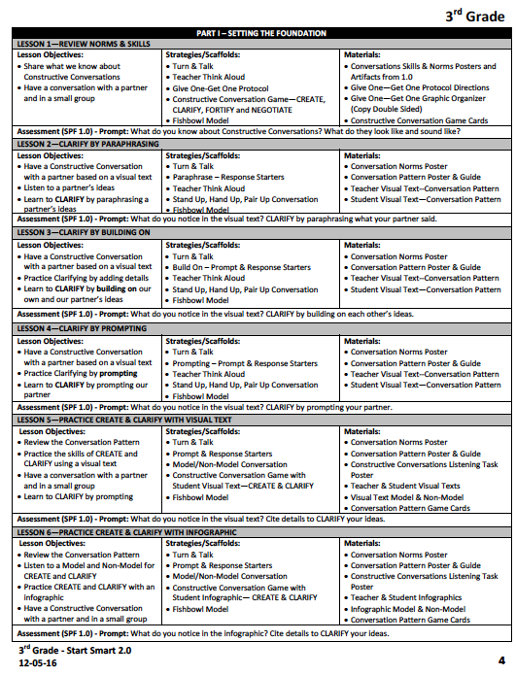
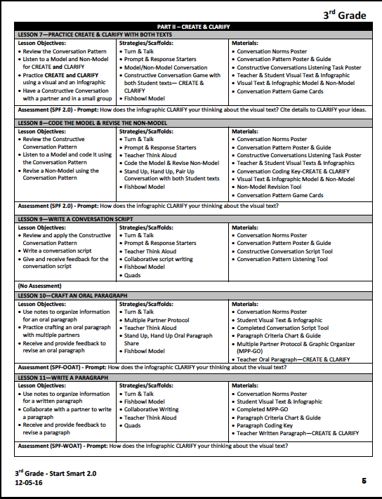
Start Smart 2.0
Formative Assessment Opportunities
There is a formative assessment opportunity during almost all lessons.
It is written in as part of the lesson, happening, for instance, through using the fishbowl strategy, rather than a stop-and-assess type of assessment.
Information gathered guides instructional decisions.
Notes:
1 minute
Use animations to share when formative assessments occur.

Slide 22

System Support
Stand Up, Hand Up, Pair Up
As we lead reclassification efforts, what systems, structures and evidence will result in improved student learning and teacher effectiveness for English Learners?
What systems and structures have you put in place or can you put in place to support teacher effectiveness in using formative assessment to guide instructional decisions ?
Notes:
5 minutes
We are going back to the reflective question we have been asking ourselves all year about system support.
Click animation
As we consider formative assessment and how it support teachers in making instructional decisions…
Click
Plese consider the following question.
After think time, click on the animation to remove the question at the top and bring in the animation for Stand Up, Hands Up, Pair Up. They have used this protocol before but go through explaining it before engaging them in using the protocol to discuss their systems and structures. (3 minutes)
After they have returned to their seats, have 2 people share out (1 minute)

Slide 23
Highlights from Start Smart 2.0
Conversation Pattern
Craft an Oral Paragraph
Write a Paragraph
Multimedia Research Project
Notes:
30 seconds
We are going to briefly lead you through some of the highlights of the Start Smart 2.0. Many of these highlights you have already mentioned when we discussed our scanning of the Table of Contents and Outline and engaged in the Give One, Get One.

Slide 24
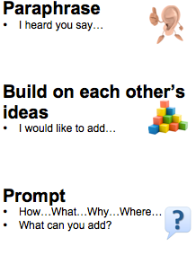
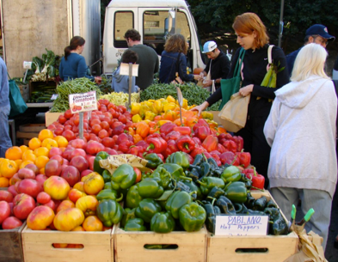

Conversation Pattern
To support students ability to clarify during a conversation and to build up an idea, students will learn a conversation pattern in which they will:
They hone these skills while analyzing visual texts and infographics based on grade-level science or social studies themes.
There are formative assessment opportunities to guide instructional decisions.
SPF 1.0
SPF 2.0
Notes:
90 seconds
Use the animations to share information about the Conversation Pattern, the resources they will be using and the formative assessment opportunities.

Slide 25
Highlights from Start Smart 2.0
Conversation Pattern
Craft an Oral Paragraph
Write a Paragraph
Multimedia Research Project
Notes:
30 seconds
Another highlight we want to share is the crafting of an oral paragraph.

Slide 26
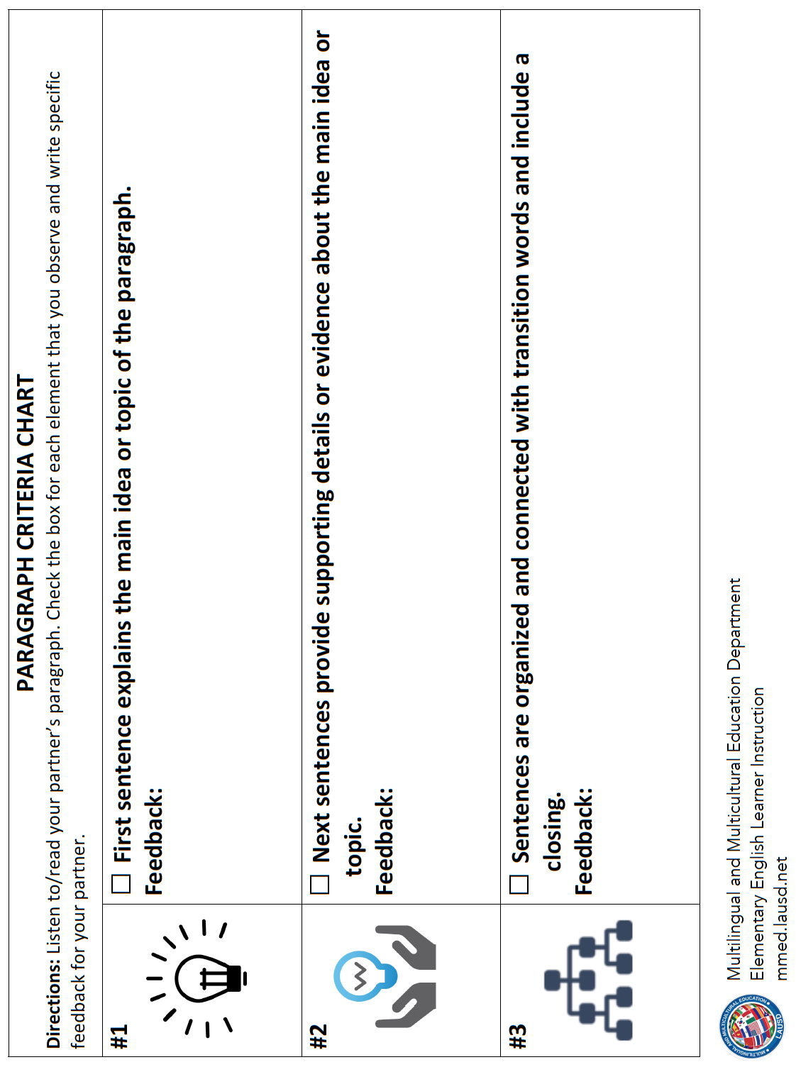
Craft an Oral Paragraph
Students will work collaboratively to prepare to craft an oral paragraph with scaffolds in place to support them in developing this skill.
Paragraph
Criteria Chart
Multiple Partner Protocol
Graphic Organizer
Paragraph
Guide
And there is a formative assessment opportunity to guide instructional decisions:
OOAT
Notes:
90 seconds
Use the animations to share information about the oral paragraph, the resources they will be using and the formative assessment opportunities.

Slide 27
Highlights from Start Smart 2.0
Conversation Pattern
Craft an Oral Paragraph
Write a Paragraph
Multimedia Research Project
Notes:
30 seconds
Another highlight we want to share is writing a paragraph.

Slide 28
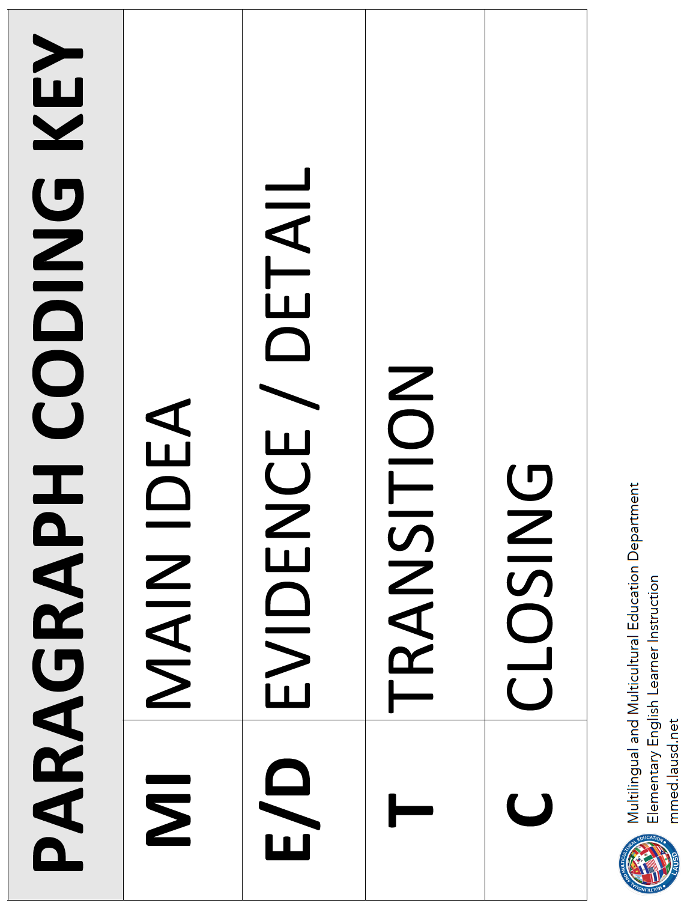
Write a Paragraph
Students will work collaboratively to prepare to write a paragraph with scaffolds in place to support them in developing this skill.
Multiple Partner
Protocol
Graphic Organizer
Paragraph Coding Key to Analyze a Model Paragraph
Paragraph
Criteria Chart
Paragraph
Guide
And there is a formative assessment opportunity to guide instructional decisions:
WOAT
Notes:
90 seconds
Use the animations to share information about the written paragraph, the resources they will be using and the formative assessment opportunities.

Slide 29
Highlights from Start Smart 2.0
Conversation Pattern
Craft an Oral Paragraph
Write a Paragraph
Multimedia Research Project
Notes:
30 seconds
Another highlight we want to share is the multimedia research project.

Slide 30

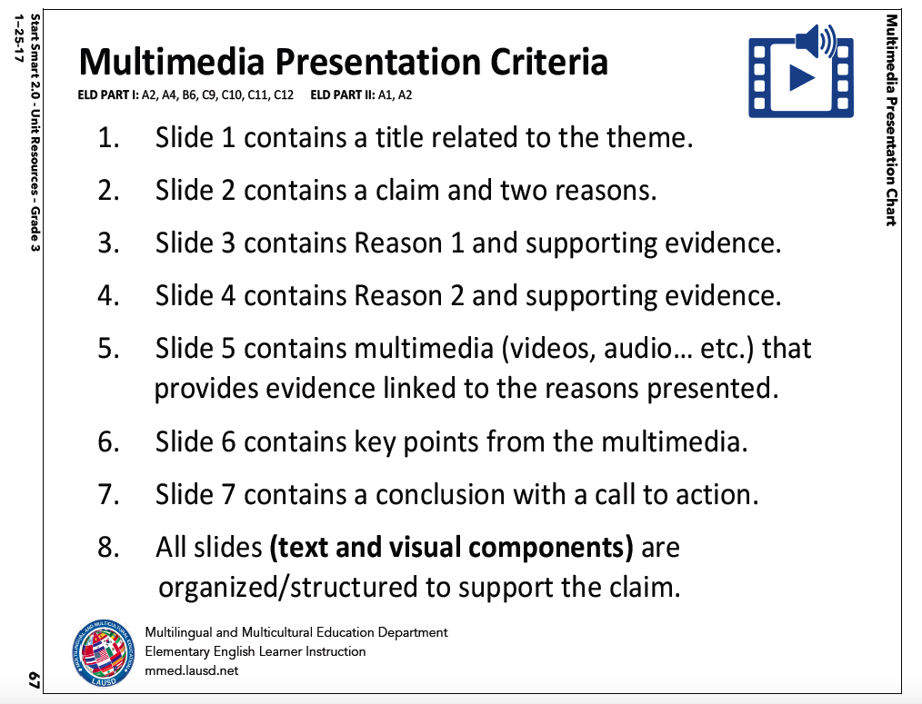
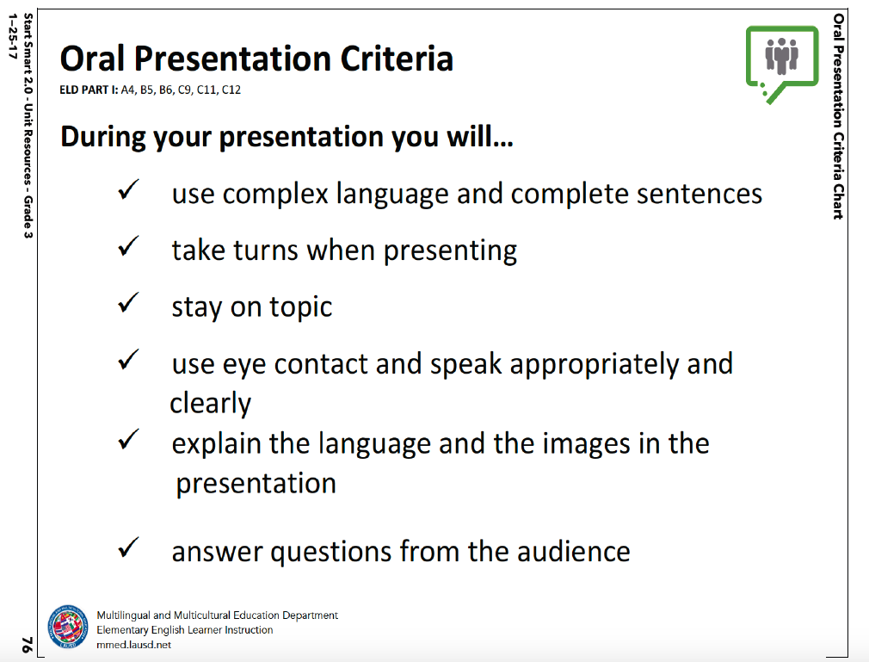
Multimedia Project
Students will work collaboratively to research the topic they have been discussing and plan, revise and present a multimedia project.
Teacher Model of Multimedia Presentation
Multimedia Presentation
Criteria Chart
Oral Presentation
Criteria Chart
And there is a formative assessment opportunity to guide instructional decisions:
SPF 2.0
Notes:
90 seconds
Use the animations to share information about the multimedia project, the resources they will be using and the formative assessment opportunities.

Slide 31
Start Smart 2.0 Strategies
Stand Up, Hand Up, Pair Up
Today you engaged in the Give On, Get One Protocol and documented 6 skills your students will be developing and/or practices your teachers will be using during Start Smart 2.0.
You also engaged in the Stand Up, Hand Up, Pair Up strategy to discuss systems and structures you have in place or could put in place to support teachers’ use of formative assessment to guide instructional decisions.
Notes:
1 minute
Use the animations to remind them of the Start Smart 2.0 strategies they used today and what they discused regarding what they should observe during instruction and what they can do to further support their teachers’ use of formative assessments.

Slide 32
System Support
As we lead reclassification efforts, what systems, structures and evidence will result in improved student learning and teacher effectiveness for English Learners?
Consider 3 commitments you can make through providing systems and structures to support teacher effectiveness in optimally utilizing the Start Smart 2.0 teaching resources to impact students’ language development?
TURN & TALK
Notes:
4 minutes
Ask the participants to consider 3 commitments that can make. Have them write them down on their handouts somewhere. Then they should turn and talk with a partner.
At the end, have 3 people share one commitment each.

Slide 33
Engaged Participant Outcomes
Review the updated monthly Reclassification Rate Monitoring Report
Discuss the LAUSD CELDT opportunity and next steps for support
Delve into Start Smart 2.0 resources to review the skills students will build and the practices teachers will use during Designated ELD instruction
Notes:
13 minutes for Introduction (Slides 1 – 9)
1 minute
These are our learning outcomes for today.
Click on animation:
Have volunteer participants read each outcome.

